Slide 1
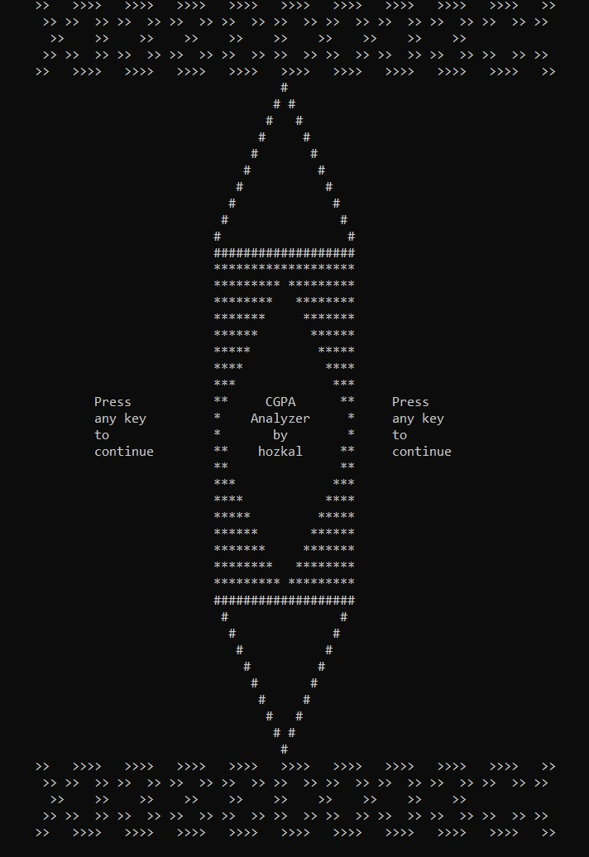
!!!Caution!!!
-type error will be exited

Slide 2
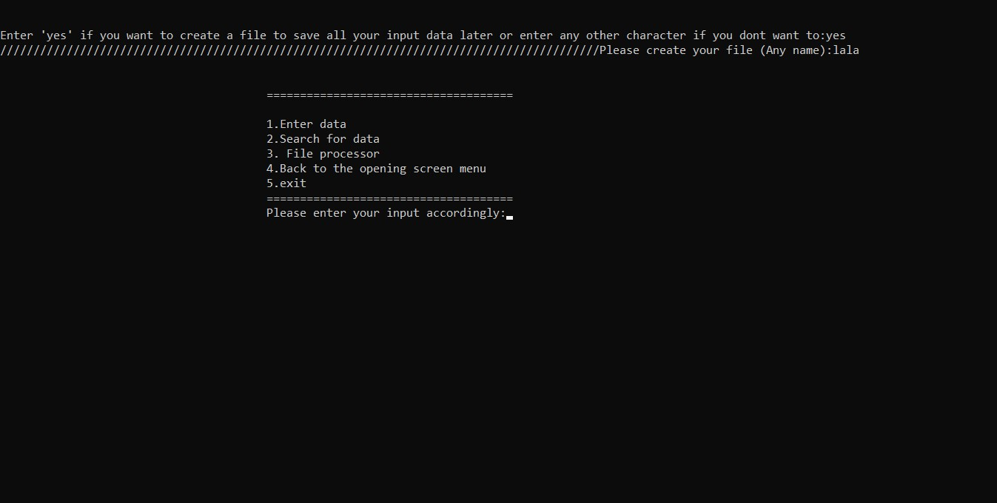
-To create file

Slide 3
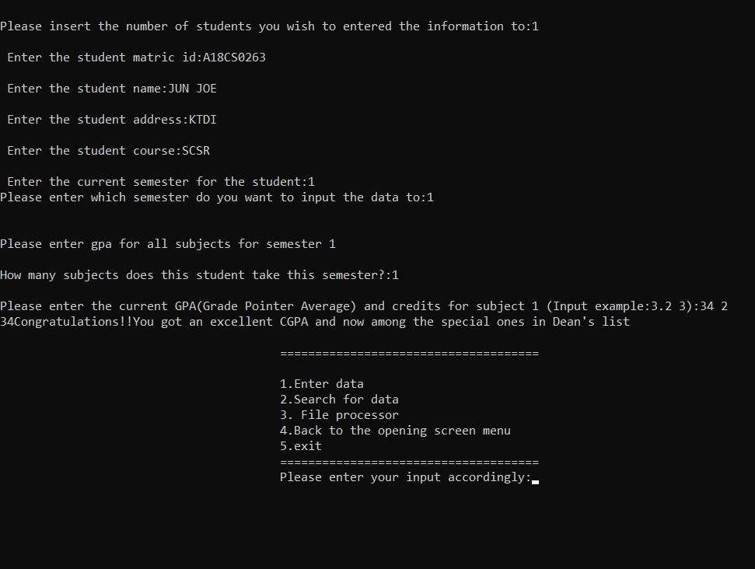

Slide 4
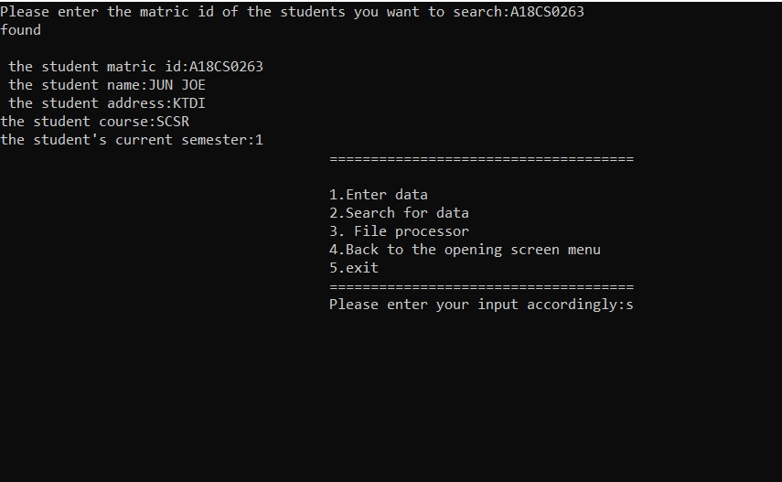

Slide 5
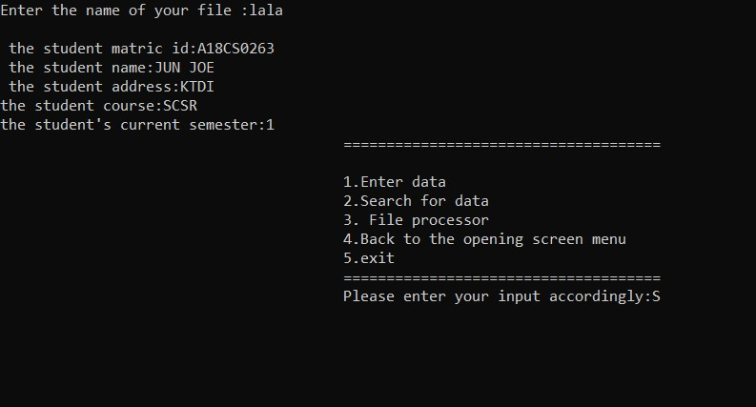

Slide 6
-Back to the screen opening menu

Slide 7

-Exit

